Slide 1

HR Data Analysis
AFAME TECHNOLOGIES Presented BY :
Simran Kaur
GitHub :
https://github.com/Milimia/Afame-Technologies-/tree/main

Slide 2
Introduction This Internship project focuses on conducting data analysis within the Human Resource Domain
We aim to explore various factors influencing employee attrition and propose strategies to enhance employee retention
HR data analysis plays a crucial role in understanding workforce dynamics, optimizing organizational processes, and fostering a positive work environment
By analysing HR data, We aim to derive actionable insights to support decision making and improve organizational performance.

Slide 3
Dataset Overview The dataset used for analysis contains employee- related information.
It include a wide range of variables such as demographics details, job related factors and performance metrics.
The data source provided directly by the company ensures the accuracy and relevance of the information.

Slide 4

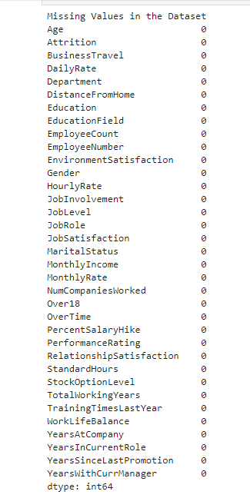
Handling Missing Values
Missing Value: NO missing Value in any columns. Each Column has 1470 non- null entries.
Data Integrity: The dataset is complete with no Missing Values, ensuring the integrity of the analysis.
Impact on Analysis: Absence of Missing values eliminates the need for imputation or exclusion of incomplete records. It facilitates a comprehensive analysis of all available data without introducing bias.

Slide 5

Summary Statistics of the Dataset
Total Records: 1470
Average Age of an employee is around 36.92 years with a minimum of 18 and a maximum of 60
On Average employees have been with the company for roughly 7 years and have spent 4.2 years in their current role.
The Average ratings for work life balance (2.76) and environment satisfaction (2.72) are slightly above the middle points, suggesting a neutral to somewhat positive perception.
There are some employees who haven’t participated in training in the last year.
Promotion frequency might be low, considering an average of 2.2 years since the last promotion.

Slide 6
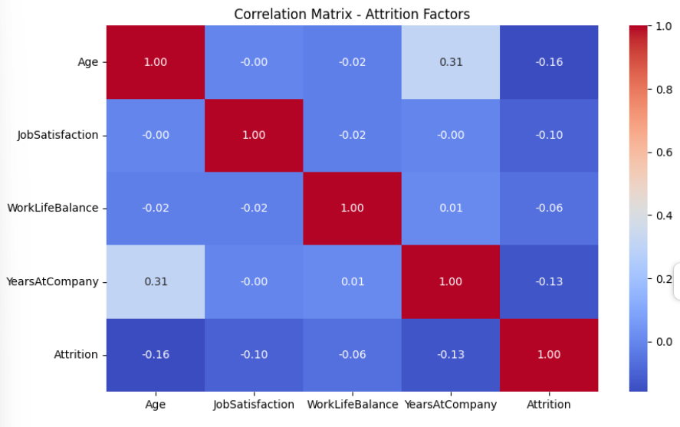
Heatmap: visualize the correlation matrix
AGE: There is a very weak negative correlation between age and attrition. This means that there might be a slight tendency for younger employees to leave the company, but the correlation is very small.
Job Satisfaction: There is a very weak negative correlation between job satisfaction and attrition. This means that employees who are more satisfied with their jobs might be slightly less likely to leave.
Work Life Balance: There is very weak negative correlation between work life balance and attrition. Similar, to the other factors this suggests a slight tendency for employees with better work life balance to be likely to leave but the effect is small.
Years at Company: there is weak positive correlation between years at the company and attrition. This means that employees who have been with the company for a longer time are slightly less likely to leave. This could be due to factors like increased seniority.

Slide 7
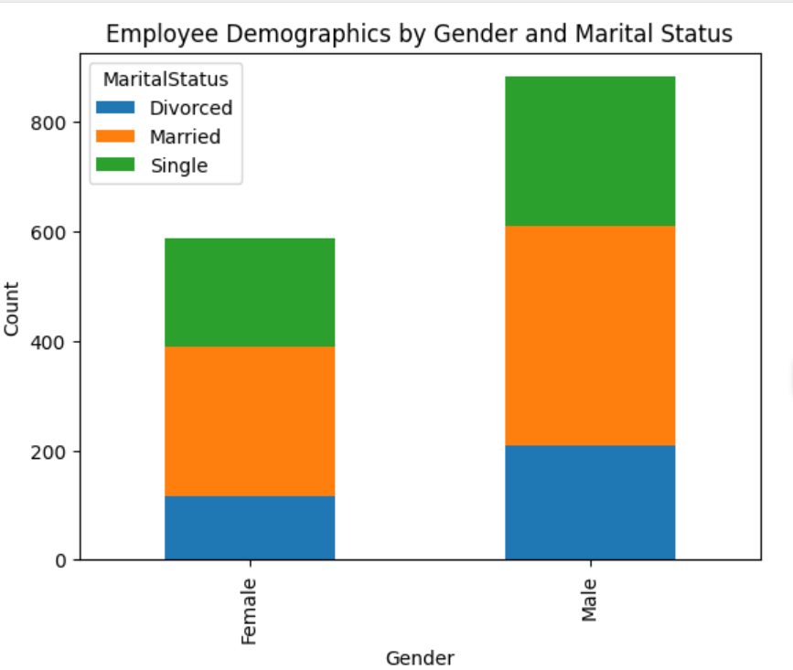
Bar Graph: Visualize Demographics by Gender and Marital Status
The graph provides a quick visual summary of the employee demographics by gender and marital status.
There are more male employees then female employees in the company.
For both genders, married is the most common marital status, followed by single and then divorced.

Slide 8
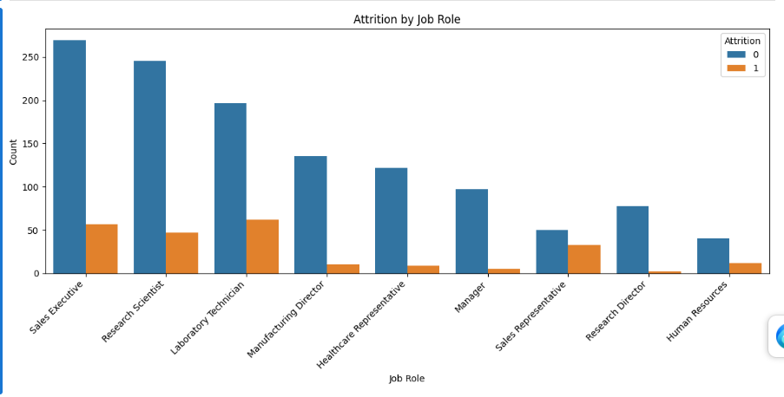
Count plot: Distribution of employee attrition across different job roles
The Graph shows that the job roles with the highest number of employees who left the company are Sales Executives (around 220), followed by Research Scientists (around 180) and Laboratory Technicians (around 160).
Conversely, the job roles with the fewer leavers seem to be Human Resources (around 20) and Managers (around 40).

Slide 9
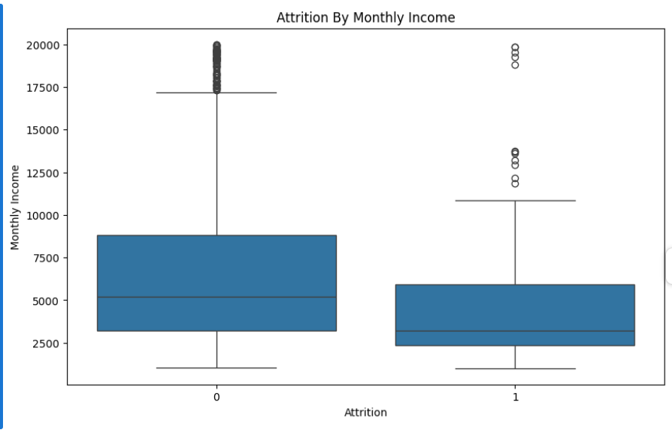
Box Plot: Relationship between monthly income and employee turnover
The Picture on right (“Attrition = NO ”) shows the income of employees who chose to stay. The box is a bit higher, suggesting they generally earn a higher monthly income.
The size of the boxes tells another story. The box for those who stayed in shorter, meaning their income is more like each other. In contrast, the box for those who left is wider, indicating more variation in their income. Some might have earned a quite a lot, while others might have earned less.

Slide 10
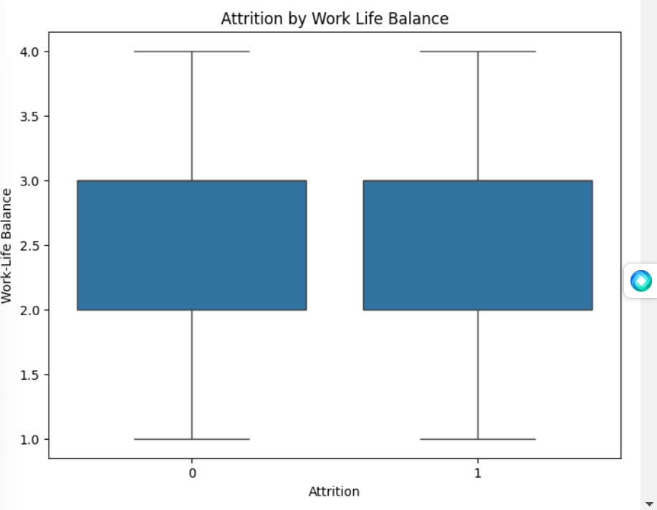
Box Plot that investigates the relationship between work life balance and attrition
The picture on the right (“Attrition = NO” ) shows the work life balance rating of employees who chose to stay. The box is a bit higher, suggesting they generally rated their work – life balance as better.
The Size of the boxes tells another story. The box for those who stayed is shorter, meaning their work- life balance ratings are more similar. In contrast, The box for those who left is wider, indicating more variation in their ratings. Some might have been very happy with their work life balance while other might have felt it was poor.

Slide 11
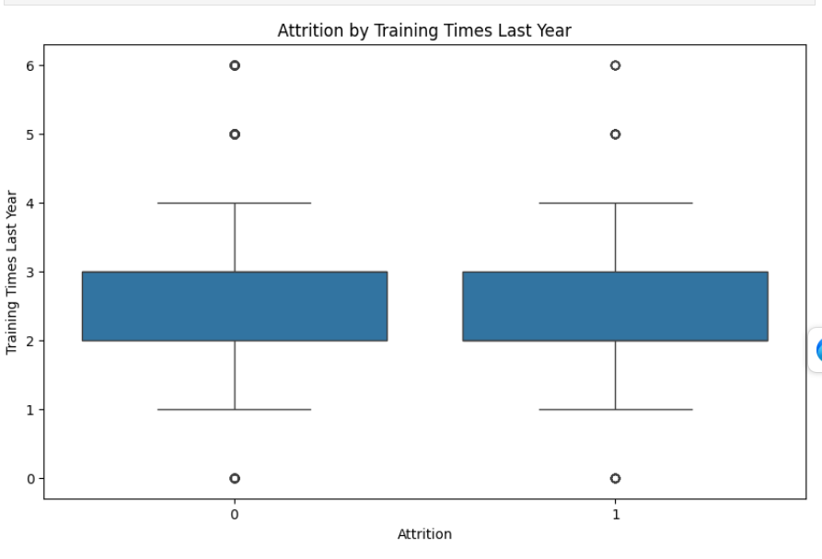
Box Plot That investigates the relationship between participation in training sessions last year
The boxplot suggests that employees who participated in more training sessions last year tend to have a lower chance of attrition. It also indicates that more participation in training might be associated with a lower likelihood of leaving the company.
There is less variation in the number of training sessions attended among employees who choose to stay with the company. Conversely, there seems to be more variation in training participation among employees who leave.

Slide 12
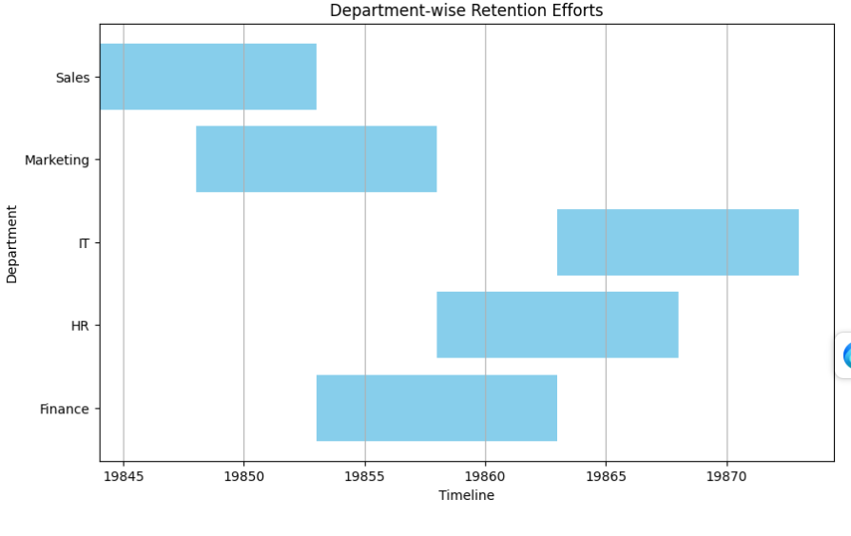
Gantt Chart : to illustrate the department involvement in retention
This chart indicates that all the departments from Sales to IT, are working on keeping employees happy (retention efforts) during time. This suggests that employee retention is a company- wide priority.
The colored bars show when each department focused on keeping employees happy.
The width of the bars indicates how long each department’s retention efforts lasts. For instance, some efforts seem shorter, like Sales and Marketing (around a Week), while others like finance or IT might be planned for a longer period (potentially Two weeks.)

Slide 13
Key Takeaways and Next Steps
Our Analysis revealed a possible correlation between several factors and employee attrition:
Employee with more tenure might be less likely to leave.
Employees who participated in more training more sessions last year might have a lower chance of attrition
Employee who received higher performance ratings might be less likely to leave.
Attrition rates might vary depending on the specific job role.
To gain deeper understanding of employee attrition, we can conduct further analysis:
Segment the data by department or job role to see if the observed relationships hold true within specific groups.
We must implement targeted strategies to address potential causes of attrition:
We must offer mentorship programs or career development opportunities to increase engagement
We must encourage participation through incentives or by making training more relevant to job roles.
We must provide constructive feedback and targeted support to improve performance
We must conduct exit interviews or surveys to understand why employees are leaving.

